Slide 1
Moss-made Biopharmaceuticals
Moss-FH
03/2018

Slide 2
Moss-FH Complement Factor H for aHUS

Slide 3
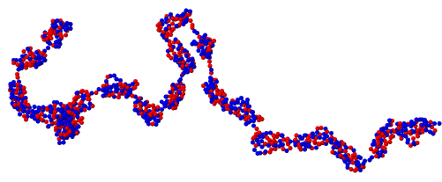
Complement factor H
Structure ^{[1]}
Approx. 150 kDa
Numerous aa-sequence polymorphisms described
20 repetitive domains (SCR)
40 di-sulfide bonds
8 N-Glycosylation sites
Function ^{[1]}
Central regulator in alternative pathway of complement system
Mutations in FH lead to:
Functional impairment
Unregulated complement activation
atypical HUS (chronic risk of complement-mediated thrombotic microangiopathy (TMA))
[1]: Merle et al, Front Immunol. 2015 Jun 2;6:262.

Slide 4
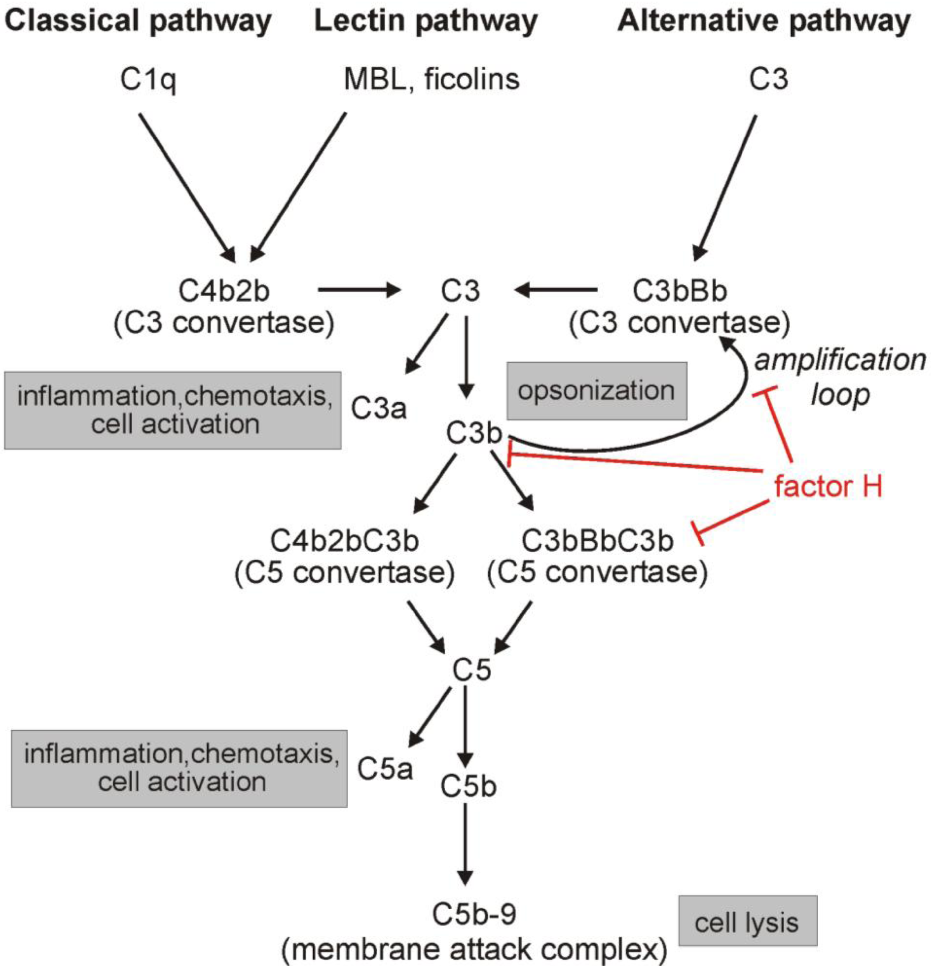
Complement System
Factor H – a central complement regulator ^{[1,2]}
Factor H is the major fluid-phase regulator of the alternative pathway, as it prevents the formation of the C3 and C5 convertases, facilitates the disassembly of already formed convertases and acts as a cofactor for the inactivation (enzymatic cleavage) of C3b.
Source: Kopp et al, 2012
[1]: Merle et al, Front Immunol. 2015 Jun 2;6:262; [2]: Kopp et al, Biomolecules 2012, 2(1), 46-75

Slide 5
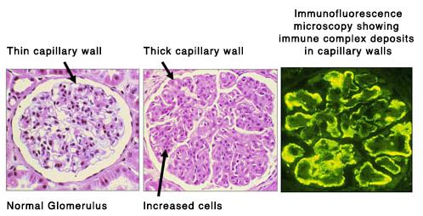
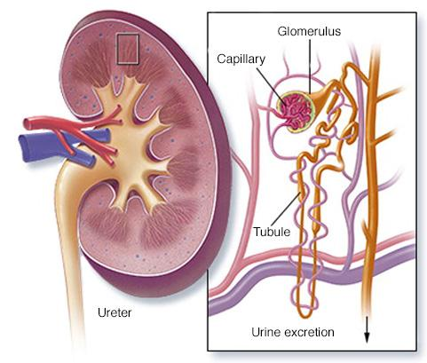
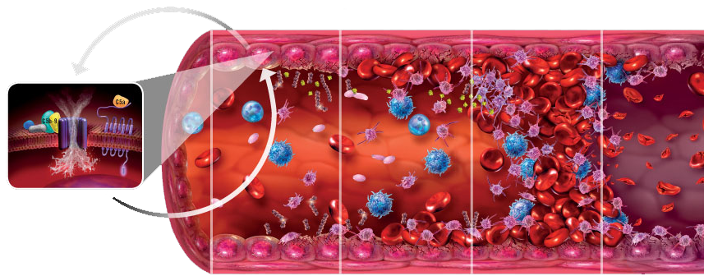
Complement Factor H
Central complement regulator
FH-mutations lead to:
C3 Glomerulopathy (C3G)
Membranoproliferative Glomerulonephritis due to C3 depositions in glomeroli
atypical HUS (aHUS)
chronic risk of complement dependant thrombotic microangiopathy (TMA)
Glomerulonephritis due to C3 depositions
TMA
Glomerulonephritis
Source: http://pnhahus.com.au

Slide 6
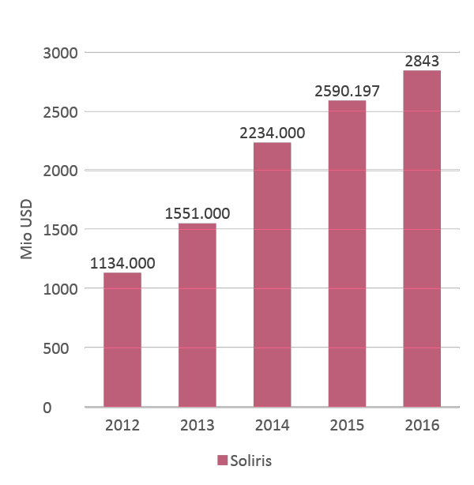
Market atypical haemolytic uremic syndrome (aHUS)
C3G
no approved therapeutic product
aHUS
Unregulated complement activation
~30% caused by mutations in human CFH gene
Atypical HUS (chronic risk of complement-mediated thrombotic microangiopathy (TMA))
Approved medical treatment
Soliris (Alexion)
monoclonal antibody (mAb)
binds to C5
Blocks formation of terminal MAC (membrane attack complex)
Approved for:
Paroxysomal nocturnal haemoglobinurea (PNH)
Atypical haemolytic uraemic syndrome (aHUS)
Source: Alexion Pharmaceuticals 2015 Annual Report

Slide 7
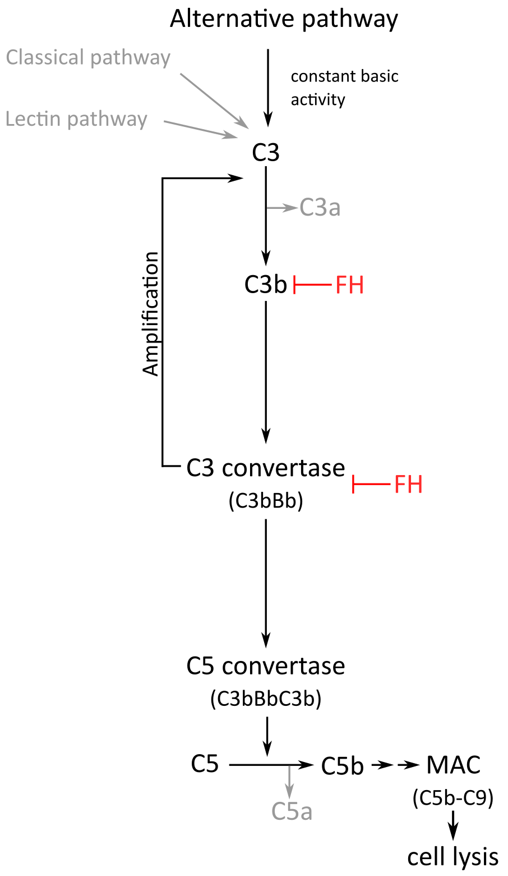
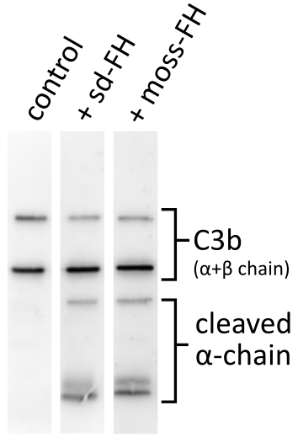
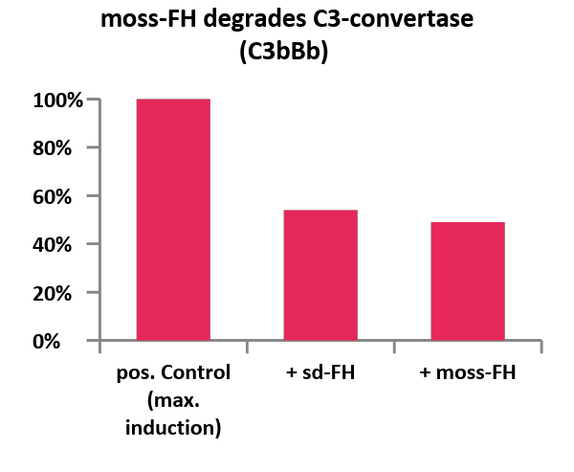
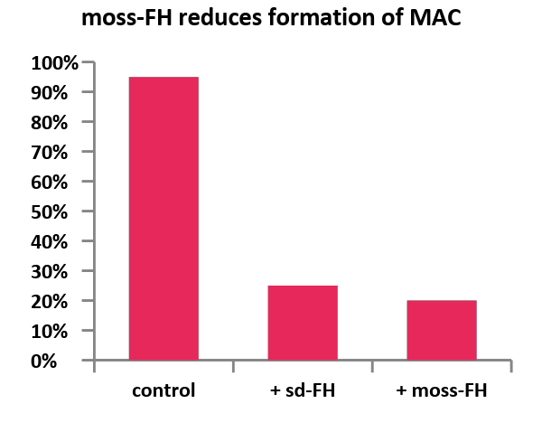
In vitro activity of moss-FH
Moss-FH:
Promotes cleavage of C3b α-chain
Degrades C3-convertase
Reduces formation of membrane attack complex
FH
FH
Soliris
Sd-FH: human serum derived FH

Slide 8
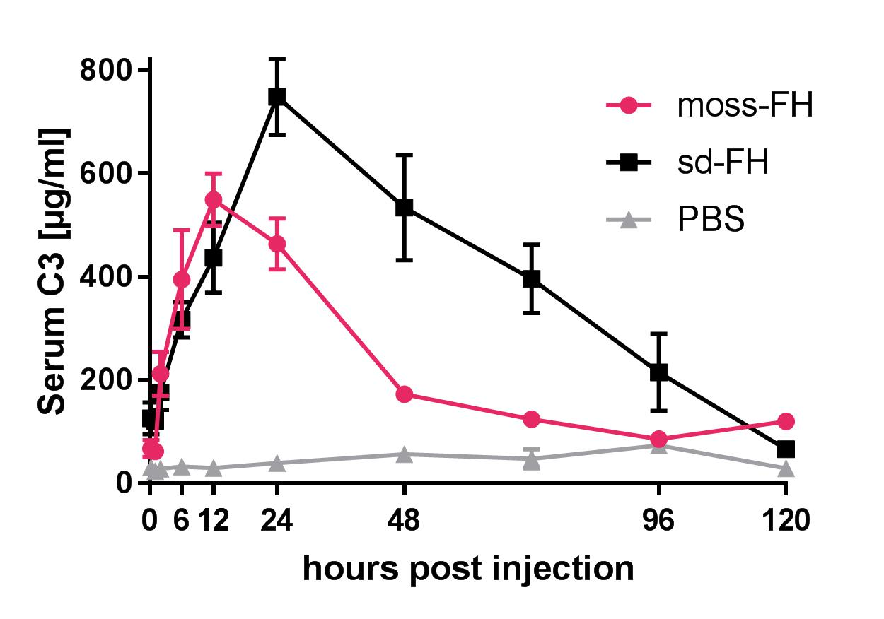
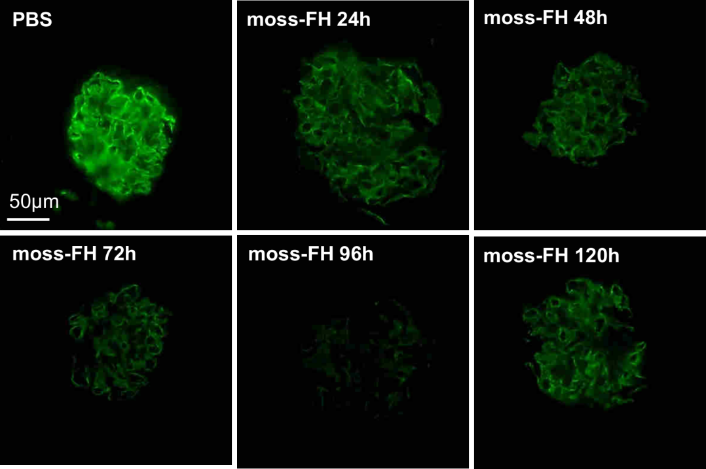
In vivo activity
Increase of serum C3 levels (assayed with C3-ELISA)
Reduction of adverse C3 deposits in mice kidney (Immunostaining)
Immunofluorescence stain, kidney, C3–Alexa488, 63x
Study setup: double i.v.-injection 2h apart, 0.5mg FH each, moss-FH (n=5), Controls (n=5; human serum derived (sd) FH and PBS)

Slide 9
^{DO IT} ^{GREENOVATION DOES IT.}
^{DO IT IN MOSS!}
www.greenovation.com

